Slide 1

CWS
Are we making the most of it?

Slide 2
Security According to Research:
Available Data: Breach Rate Comparison
The most straightforward study found was conducted by ITIC (Information Technology Intelligence Consulting)
in 2022 and published in November of that year.
This study compared breach rates across different platforms with the following results:
Plataform | Security Breach Rate (%)
Mainframes IBM Z (z/OS) | 0,1%
X86 Servers | 2%

Slide 3
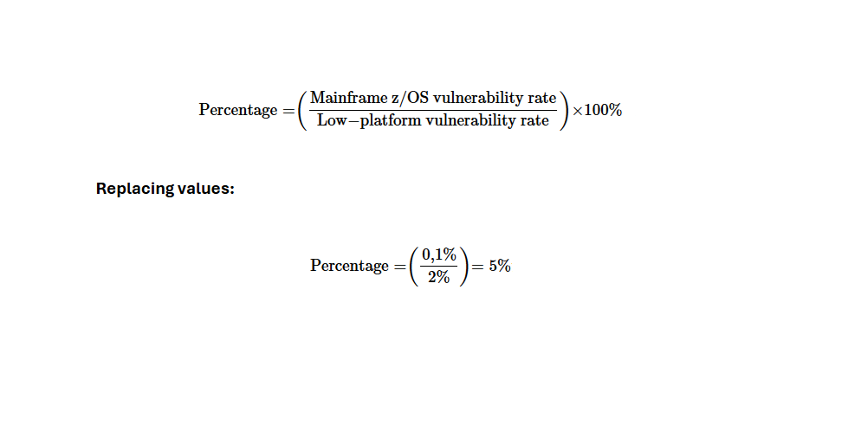
Security According to Research:
These numbers indicate that only 0.1% of IBM Z mainframes experienced downtime due to security breaches,
while 2% of Windows/Linux servers reported successful hacks.
To calculate the breach percentage of z/OS mainframes compared to low-platform servers, we used the formula:

Slide 4
Security According to Research:
This means that the breach rate for z/OS mainframes is 5% of the breach rate for x86 servers, based on this data.
In practical terms, for every 100 x86 servers that suffer breaches, only 5 z/OS mainframes would be breached,
assuming an equal number of systems.

Slide 5
Benefícios
✅ Key Benefits
• Lower latency: The response goes directly from CICS to the browser. No extra hops.
• Less infrastructure: No middleware layers = fewer servers, less maintenance.
• Security: No unnecessary transfers of sensitive data to external systems.
• Consistency: Logic remains on the mainframe, which usually has the strongest security/audit policies.
• Simplicity: Fewer moving parts, easier to troubleshoot and evolve.

Slide 6
Why Mainframe?
Reliability and availability → Critical systems like banks, government, and healthcare depend on its stability
(99.999% uptime).
Security → Robust architectures against cyberattacks.
High-volume processing → Massive transactions (e.g., credit cards, payroll).
Modernization → Current mainframes support Linux, Kubernetes, REST APIs, and cloud integration
(IBM Z Hybrid Cloud).

Slide 7
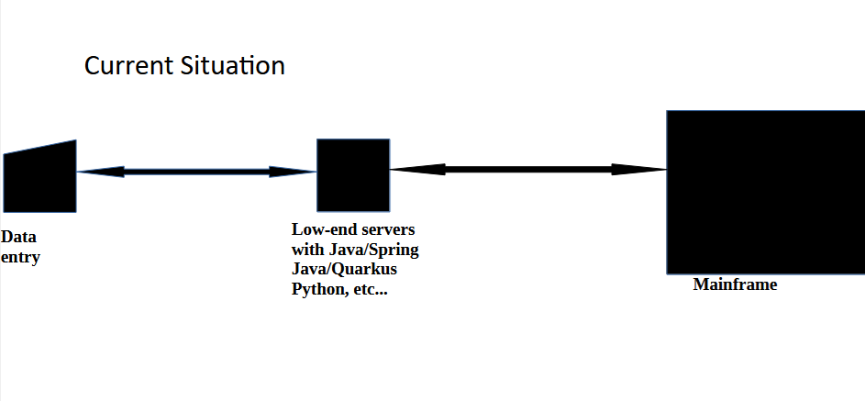
Current Situation

Slide 8
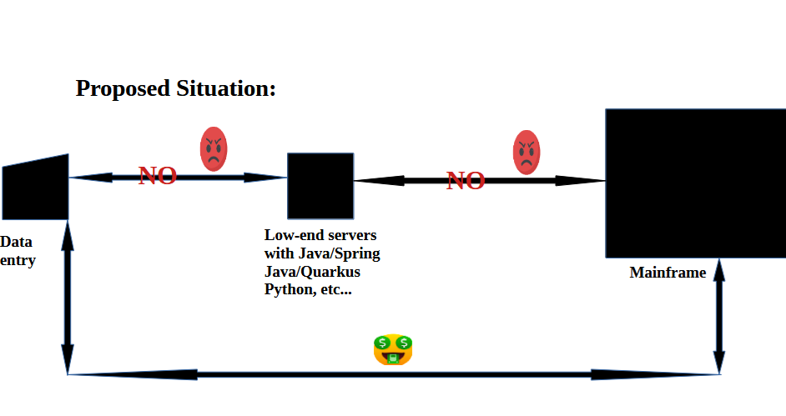
Proposed Situation:

Slide 9
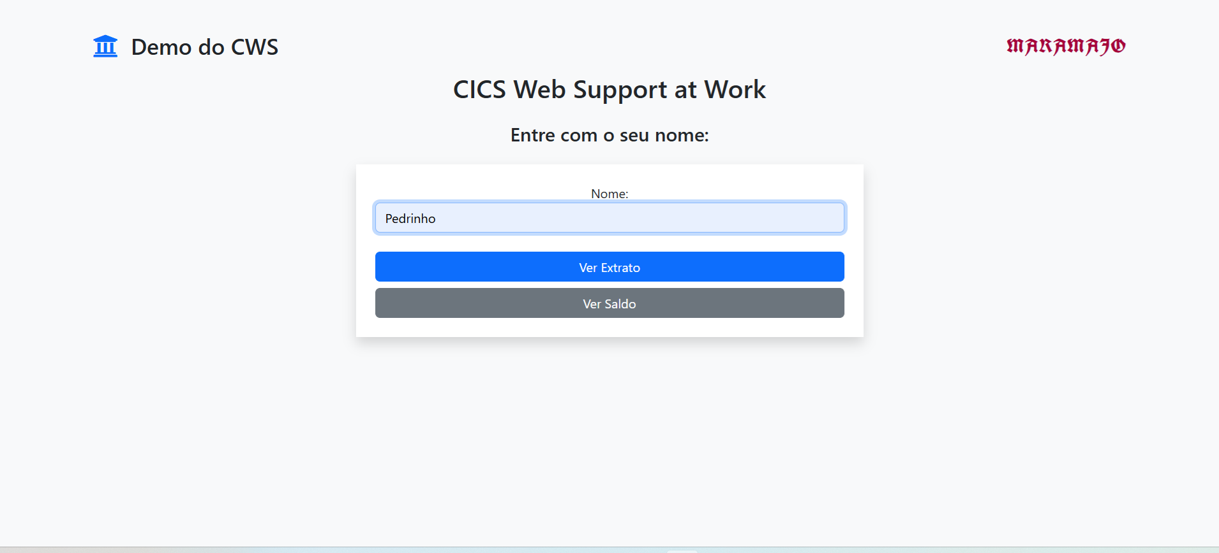
Some Examples:

Slide 10
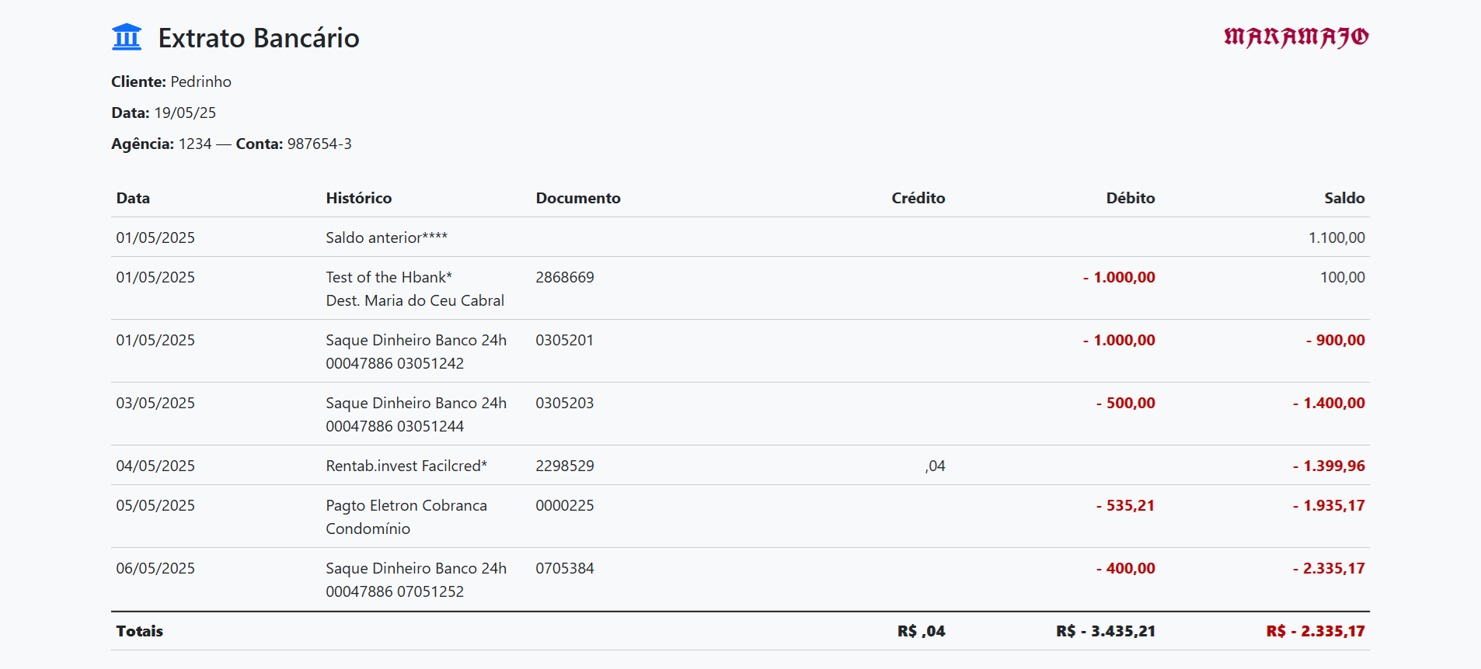
Some Examples:

Slide 11
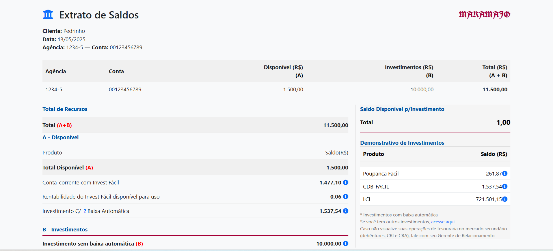
Some Examples:

Slide 12
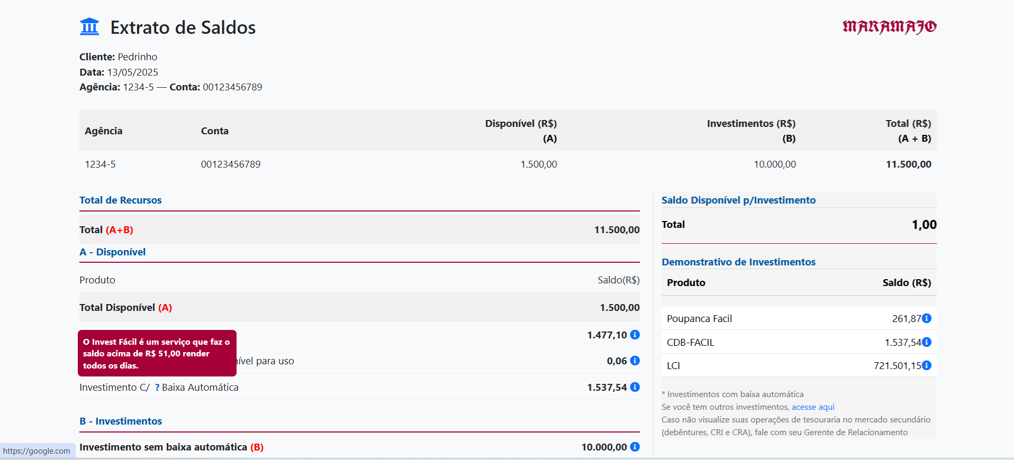
Some Examples:

